Slide 1

Fake and Real News Prediction with NLP & Machine Learning

Slide 2


Neha Gupta
Group 1
Vijaya Dafale
Shlok Jain

Slide 3
Objective
utilizing fake and real news prediction models is to develop robust and accurate algorithms that can discern between misinformation and genuine news articles.
Through the development of accurate predictive models, the aim is to actively contribute to the ongoing battle against the proliferation of misinformation, fostering a more reliable and trustworthy information ecosystem in the digital era.

Slide 4
Project Scope
This project is to develop and deploy robust machine learning models for the accurate prediction of fake and real news.
By leveraging advanced techniques such as TF-IDF vectorization and machine learning algorithms (Naive Bayes, Random Forest, Logistic Regression), the project aims to enhance media literacy and provide individuals with effective tools to discern misinformation from authentic content.
The scope includes comprehensive data analysis, visualization through word clouds, model evaluation with cross-validation and hyperparameter tuning, and ultimately, the deployment of a Random Forest Classifier for real-time predictions.

Slide 5
Agenda
Project Workflow
Data Collection and Understanding
EDA & Data Preprocessing
Feature Engineering
Model Development and Evaluation
Model Selection
Deployment
Predictions on New Data
Challenges Faced
Conclusion and Insights

Slide 6
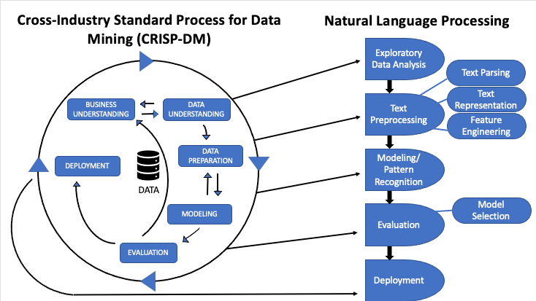
Project Workflow

Slide 7
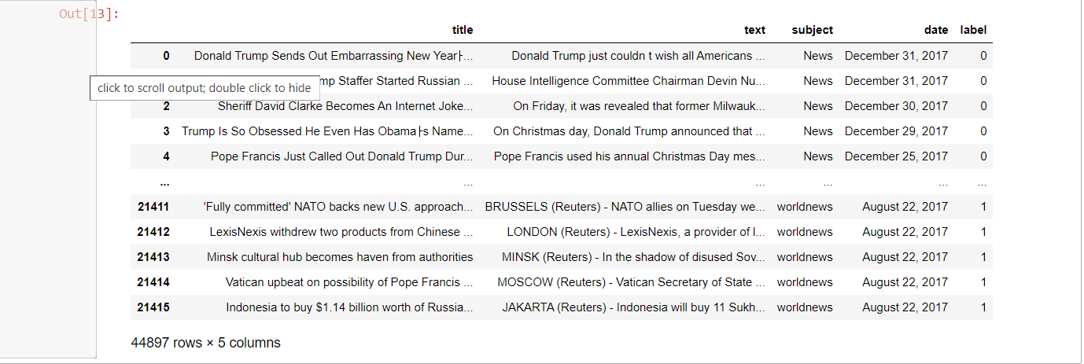
Data Collection
The dataset is a part of the data collection process. To effectively use it for prediction, you would need to ensure data quality.
The compiled dataset consists of a substantial number of news articles labeled as either fake or real.
Label (1) = Real News
Label (0) = Fake News
Each entry in the dataset includes the textual content of the article and its corresponding label.

Slide 8
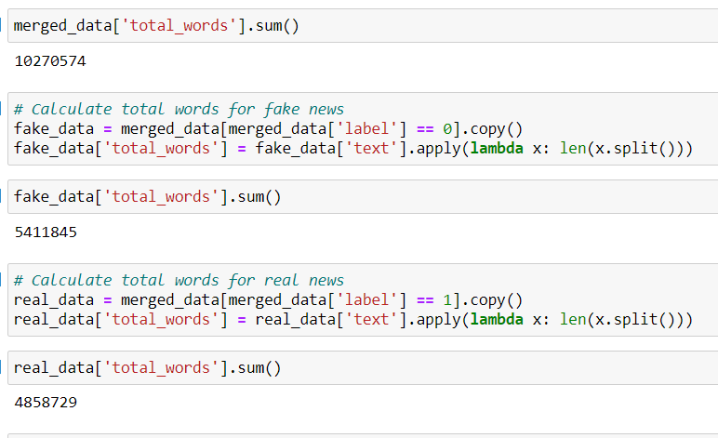
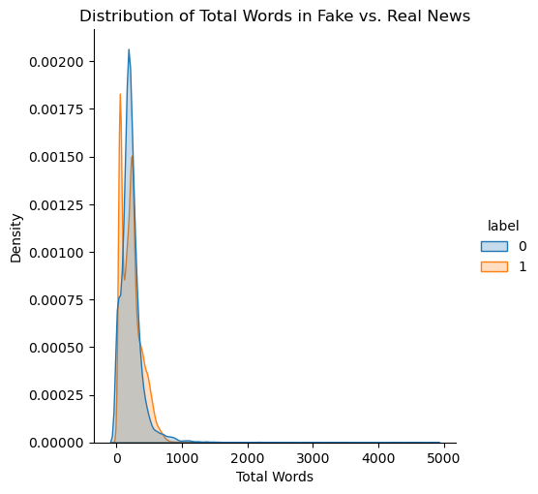
Data Preprocessing Text Preprocessing:
Text Cleaning:
Removed HTML tags from the text.
Lowercased the text, removed numbers, and removed punctuation.
Tokenized the text into words.
Removed stopwords using NLTK's English stop words.
Text Analysis:
Calculated the total number of words in the entire dataset, fake news, and real news.
Visualized the distribution of total words in fake vs. real news using a kernel density estimate (KDE) plot.
This analysis provides insights into the word count distribution in both fake and real news, allowing for a better understanding of the length of the textual content in the dataset.

Slide 9
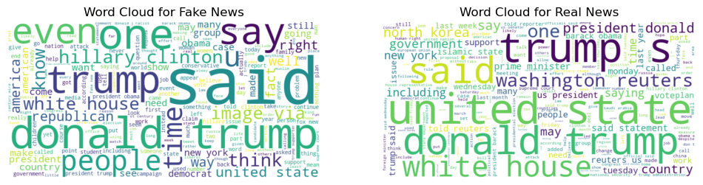
Feature Engineering:
Word Cloud Visualization without TF-IDF:
This approach provides a visual representation of the most frequent words in the raw text data without considering the TF-IDF weights.
weighting mechanisms may highlight common words that appear in both fake and real news, making it challenging to discern meaningful differences.
The word clouds generated this way are more reflective of the most frequent words in the entire corpus, which might not be effective for distinguishing between the two classes.

Slide 10
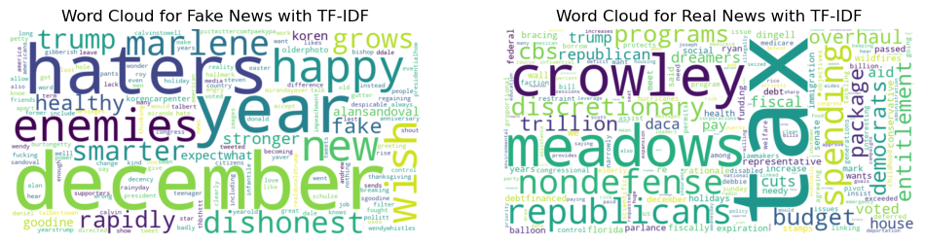
Continued,
2. Word Cloud Visualization with TF-IDF Vectorizer:
To capture more informative features and differences between fake and real news, the TF-IDF approach considers not only word frequency but also the importance of words in the context of the entire dataset. This can help in identifying words that are more unique or characteristic of each class.
These visualizations offer an intuitive understanding of the most prominent words in both fake and real news, aiding in the interpretation of key themes within the dataset.

Slide 11
Transform Text with TF-IDF Vectorizer
Utilization of Tfidf Vectorizer:
Employed the Tfidf Vectorizer from scikit-learn to transform the raw text data into numerical feature vectors.
Executed this process separately for unigrams, bigrams, and trigrams, enabling the capture of diverse contextual information within the textual content.
Tokenization for Semantic Capture:
Implemented tokenization, breaking down the text into individual words or phrases, to capture the semantic meaning embedded in the content.
This step is crucial for understanding the structure and nuances of the language used in the dataset.
TF-IDF Transformation:
Applied the TF-IDF transformation technique to the tokenized text.
TF-IDF assigns weights to each term based on its significance in the documents, facilitating the conversion of raw text data into a format conducive to machine learning models.

Slide 12
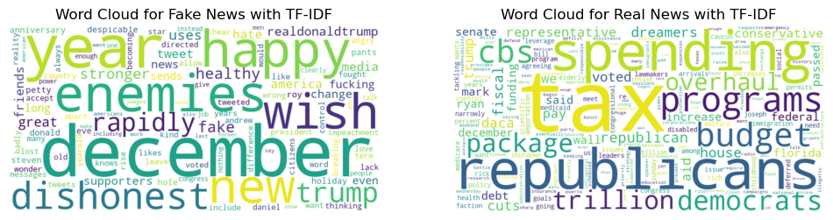
Continued,
In an effort to capture the distinctive features of fake and real news, we explored different levels of context by employing unigram, bigram, and trigram TF-IDF vectorization.
However, the resulting word clouds from bigram and trigram analyses did not yield meaningful insights.
Consequently, we have chosen to proceed with unigram TF-IDF vectorization for further analysis, as it provides a clearer representation of key terms that differentiate between fake and real news

Slide 13
Model Development and Evaluation:
For the model development of fake and real news classification, three distinct models have been chosen: Naive Bayes, Random Forest, and Logistic Regression.
Naive Bayes:
Strengths:
Well-suited for text classification tasks.
Efficient and computationally inexpensive.
Handles high-dimensional data well.
Rationale:
Naive Bayes is a probabilistic model that works particularly well with text data, making it a natural choice for classifying news articles. Its simplicity and efficiency are advantageous for quick and effective classification.
Random Forest:
Strengths:
Robust and resistant to overfitting.
Handles non-linearity and interactions in data.
Suitable for both classification and regression tasks.
Rationale:
Random Forest is an ensemble learning method that builds multiple decision trees and combines their outputs. Its robustness and ability to capture complex relationships make it suitable for discerning patterns in news articles, especially when dealing with potentially intricate features.
Logistic Regression:
Strengths:
Simple and interpretable.
Effective for binary classification tasks.
Provides probability estimates.
Rationale:
Logistic Regression is a straightforward yet powerful model for binary classification. Its interpretability is valuable in understanding the factors contributing to the classification of news articles as fake or real. Additionally, it provides probability estimates, offering insights into the model's confidence.

Slide 14
Evaluation with Cross Validation and Hyperparameter Tuning
TF-IDF Vectorization : All three models are applied after TF-IDF vectorization of the text data. This transformation captures the importance of terms in the corpus, making it suitable for textual information.
Cross Validation: Cross-validation is a crucial step in model evaluation, ensuring robustness and reliability of the chosen models. In this project, a Stratified K-Fold cross-validation approach is employed.
Stratified K-Fold:
Divides the dataset into K folds while preserving the percentage of samples for each class.
Ensures that each fold is representative of the overall class distribution.
Train-Test Split: The dataset is split into training and testing sets using stratified sampling to maintain the balance of classes in both sets.
Stratified Sampling:
Ensures that the proportion of fake and real news is maintained in both the training and testing sets.
Hyperparameter Tuning: Hyperparameter tuning is performed to optimize the performance of the models by systematically searching the hyperparameter space.
Models and Parameters:
Naive Bayes:
No hyperparameters are tuned explicitly.
Random Forest:
Number of Estimators (n_estimators).
Logistic Regression:
Regularization strength (C).
Penalty (L1 or L2).
GridSearchCV: GridSearchCV is employed for hyperparameter tuning, systematically searching through a predefined hyperparameter grid and selecting the combination that maximizes model performance.

Slide 15
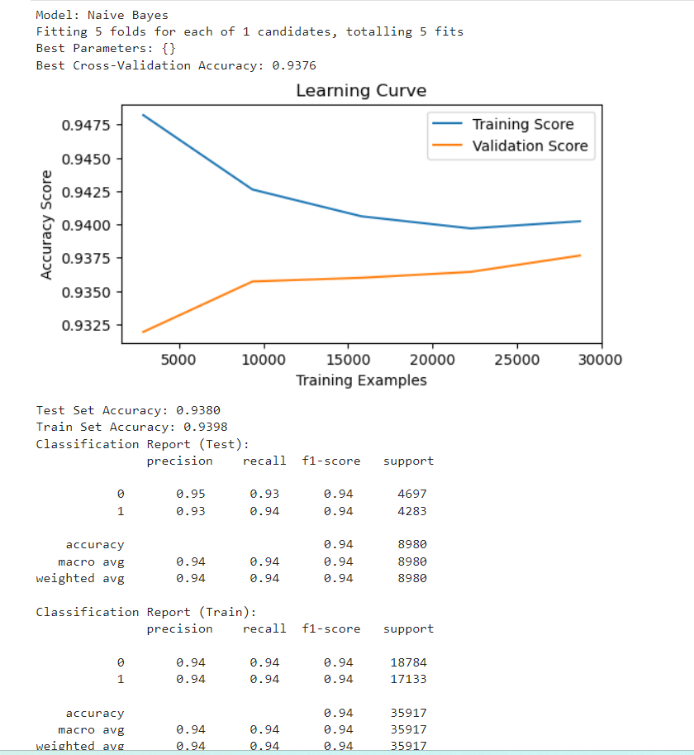
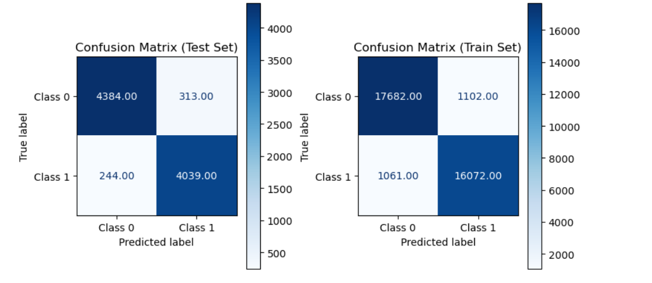
Naive Bayes -
Evaluation Metrics: The performance of each model is assessed using accuracy, precision, recall, F1-score, and confusion matrices.
Learning Curve Analysis: Learning curves are analyzed to understand how the models' performance evolves with the increasing size of the training set. This helps identify overfitting or underfitting issues.

Slide 16
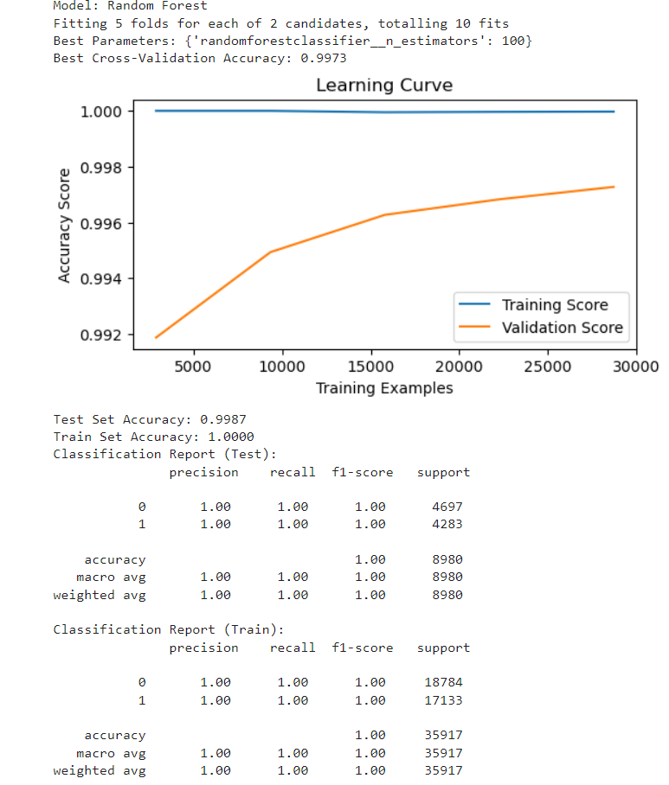
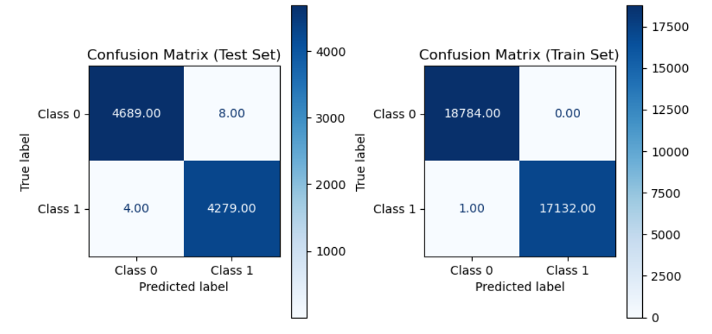
Random Forest Classifier -
Evaluation Metrics: The performance of each model is assessed using accuracy, precision, recall, F1-score, and confusion matrices.
Learning Curve Analysis: Learning curves are analyzed to understand how the models' performance evolves with the increasing size of the training set. This helps identify overfitting or underfitting issues.

Slide 17
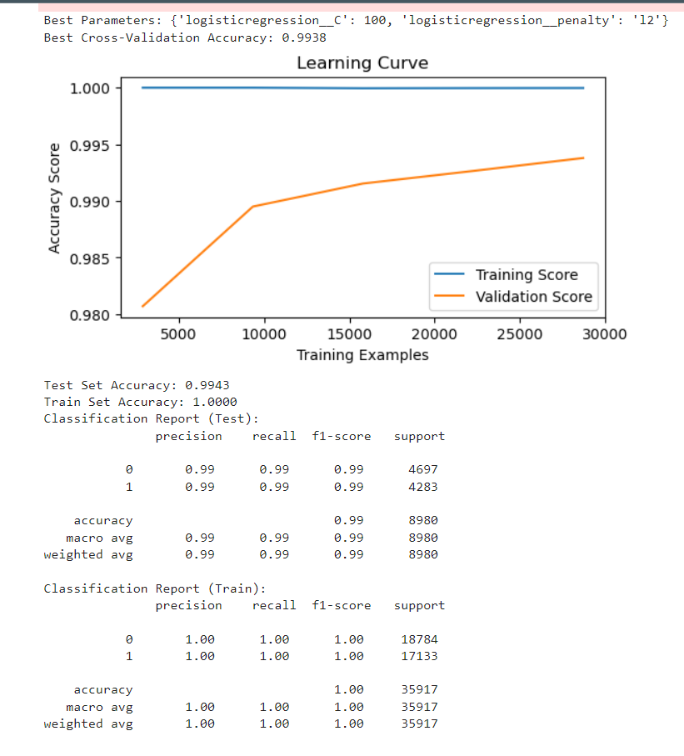
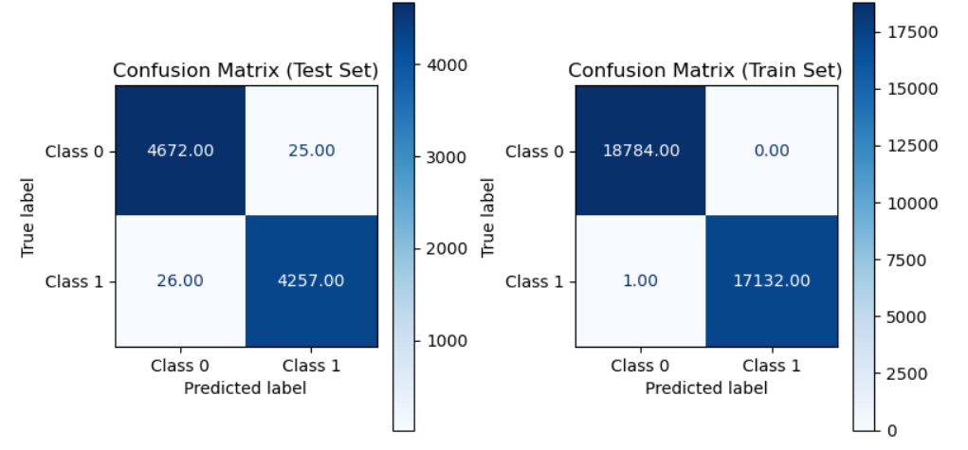
Logistic Regression -
Evaluation Metrics: The performance of each model is assessed using accuracy, precision, recall, F1-score, and confusion matrices.
Learning Curve Analysis: Learning curves are analyzed to understand how the models' performance evolves with the increasing size of the training set. This helps identify overfitting or underfitting issues.

Slide 18
Model Selection: Random Forest Classifier
we opted for the Random Forest classifier due to its excellent performance, achieving a high accuracy of 99.87% on the test set and perfect accuracy of 100% on the training set with the specified hyperparameters (n_estimators=100).
The model was trained on the TF-IDF vectorized data with unigram features, leveraging the Tf-idf Vectorizer from scikit-learn.
The dataset was split into training and testing sets using stratified sampling.
The classifier exhibited exceptional accuracy, precision, recall, and F1-score on both the test and training sets, as evidenced by the classification reports.
The confusion matrices visually represent the model's ability to correctly classify instances, demonstrating minimal misclassifications

Slide 19
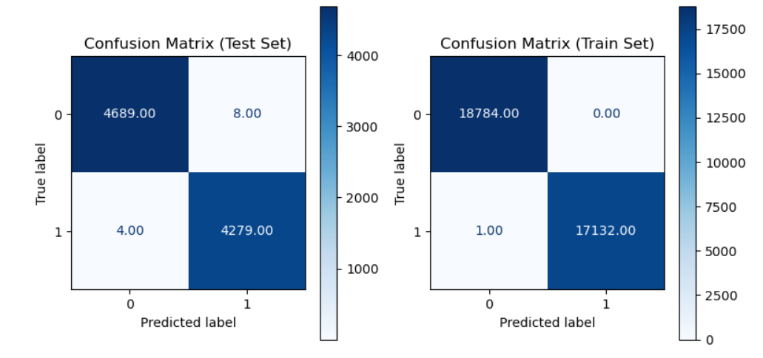
Model Selection: Random Forest Classifier
The high accuracy and robust performance on both training and testing data indicate the Random Forest classifier's suitability for our fake and real news classification task

Slide 20

Deployment: Local Deployment
Model deployment is a crucial step in making machine learning models accessible to users.
The code we provided is for deploying a Fake and real news prediction using Streamlit, a popular Python library for creating web applications

Slide 21
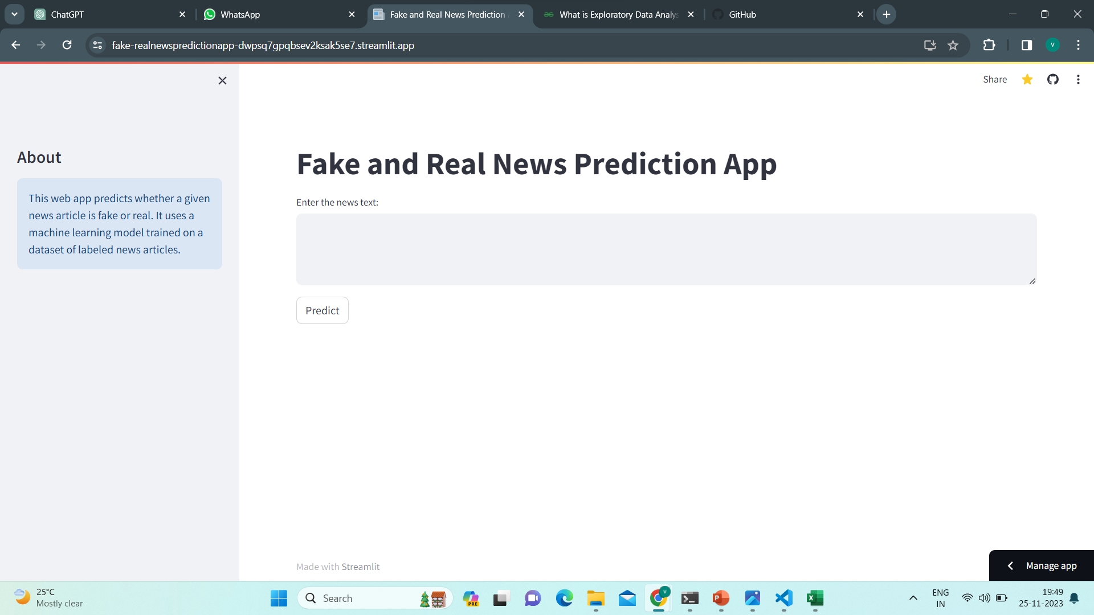
Deployment: Global Deployment
App link : https://fake-realnewspredictionapp-dwpsq7gpqbsev2ksak5se7.streamlit.app/

Slide 22
Challenges Faced
Data Quality: Ensuring the quality and reliability of the labeled dataset posed challenges, as inaccuracies or biases in labeling could impact model performance.
Model Selection: Choosing the most suitable model for fake and real news classification involved experimenting with various algorithms to find the optimal balance between accuracy and generalization.
Hyperparameter Tuning: Due to the significant time required for cross-validation and hyperparameter tuning, the exploration of a broader range of hyperparameters was limited, potentially affecting the model's fine-tuning.

Slide 23
Conclusion
Summary of Findings:
The project successfully tackled the challenging task of distinguishing between fake and real news articles.
The implemented models, including Naive Bayes, Random Forest, and Logistic Regression, demonstrated strong performance, achieving high accuracy in classification.
Project Achievements:
Developed robust machine learning models leveraging advanced techniques in natural language processing and classification.
Implemented a Streamlit web application for real-time predictions, providing an accessible interface for users to evaluate news authenticity.

Slide 24


